Slide 1


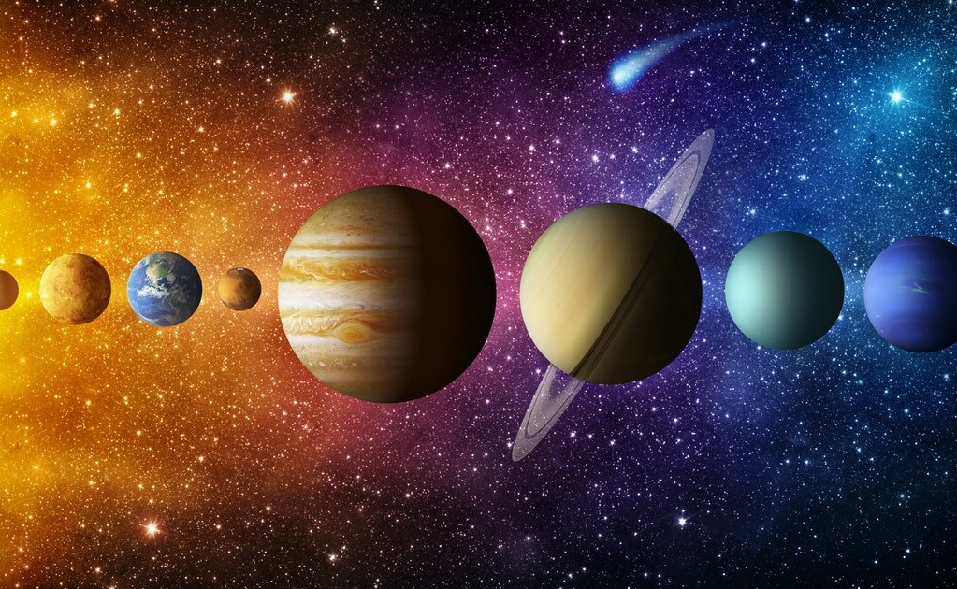

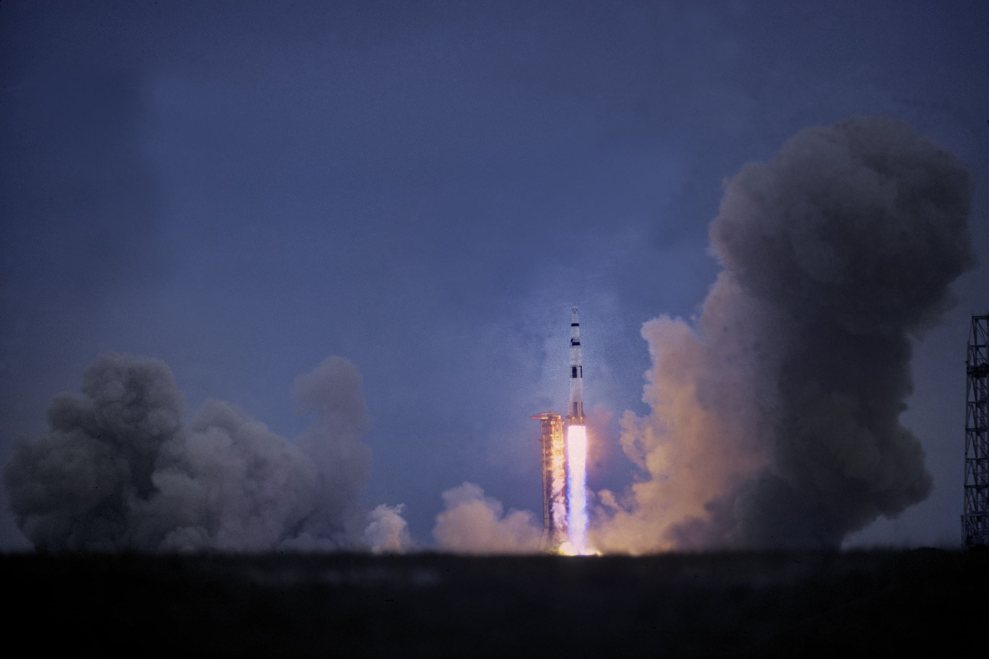
Feature Key points
z
The game will feature famous car racers
The player will be able to race on different planets
Player can explore space to find better parts for their car

Slide 2
Market Analysis
The game will be like all the typical racing games.
The customer will be people who love racing.
Expected sales 50 euro.

